Slide 1

LayerNorm
An optimal component for parameter-efficient fine-tuning

Slide 2
Computationally expensive
Solution: Only train a portion of the model!
Require more data
Large number of parameters
Poor OOD performance
Overfitting

Slide 3

Bidirectional Encoder Representations from Transformers (BERT)
This work is based on BERT
BERT revolutionized NLP field and marked the beginning of a new era in NLP
12 layers, 110 million parameters (BERT base)
Pre-trained on English BooksCorpus (800M words) + Wikipedia (2,500M words)
Used in Google search
There are many domain-specific BERT models: BioBERT, LEGAL-BERT, ClinicalBERT
But there is no BERT for drug labels
Devlin, J., Chang, M. W., Lee, K., & Toutanova, K. (2018). Bert: Pre-training of deep bidirectional transformers for language understanding. arXiv preprint arXiv:1810.04805.

Slide 4

Partial Training
Which component to train?
Which component of BERT undergoes the most change in full fine-tuning?
General Language Understanding Evaluation (GLUE)
For each component, we compared the value of the pre-trained model parameter with the value in the fine-tuned model
$$D=\frac{1}{n}\sum_{i=1}^{n}{\left|{C_{pre}}_{i}−{C_{fine}}_{i}\right|}$$

Slide 5
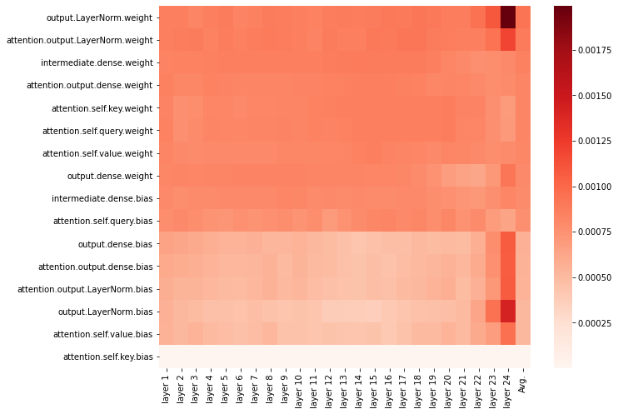
Drastic change
STS-B

Slide 6
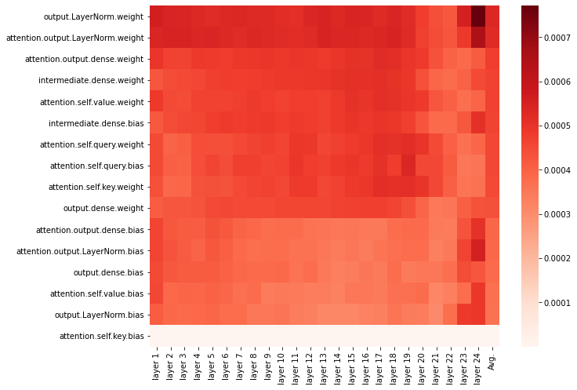
Drastic change
RTE

Slide 7
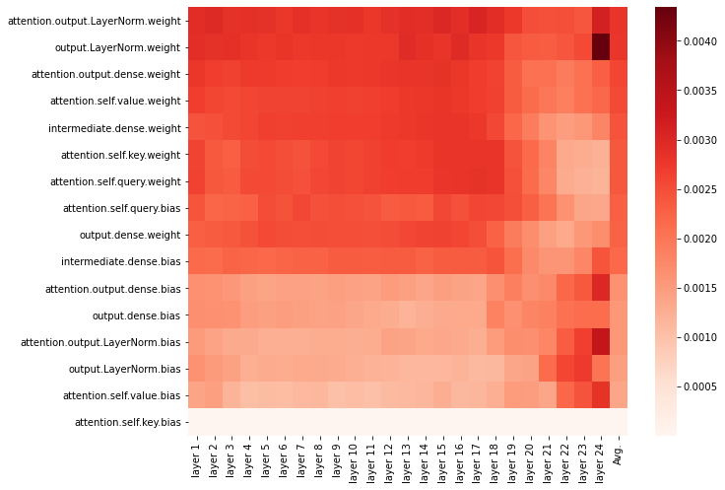
Drastic change
SST-2

Slide 8
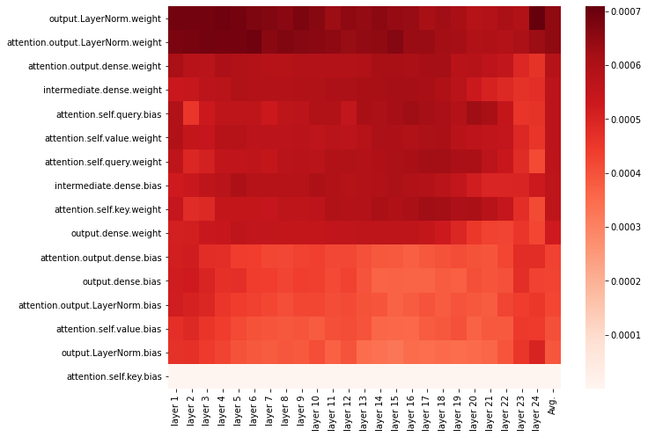
Drastic change
MRPC

Slide 9
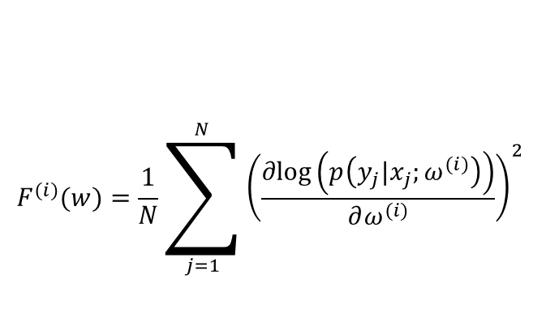

Search for the most important component using Fisher information
Fisher Information
Estimation of how much information a variable carries about a parameter of a distribution
$N$: number of samples, $x_{j}:$ $j$-th input sample, $y_{j}$: $j$-th output, $ω^{(i)}$: $i$-th parameter,
$$F^{(i)}(w)=\frac{1}{N}\sum_{j=1}^{N}{{\left(\frac{∂log\left(p\left(y_{j}|x_{j};ω^{(i)}\right)\right)}{∂ω^{(i)}}\right)}^{2}}$$

Slide 10
Fisher Information
General Language Understanding Evaluation (GLUE)
Show the data to the pre-trained model and calculate Fisher Information
Average Fisher Information of each parameter in each task
For each task, normalize the Fisher information of all component by dividing to the sum
Average over all tasks
Sort components based on their Fisher Information
Rank | Component
1 | output.LayerNorm
2 | attention.output.LayerNorm
3 | attention.output.dense
4 | attention.self.value
5 | output.dense
6 | attention.self.query
7 | intermediate.dense
8 | attention.self.key

Slide 11
Pruning LayerNorm
Generally, transformer models are remarkably robust to pruning
Performance of models from the BERT family degrades significantly if one component, LayerNorm, is disabled
As an example, removing only 24 parameters in LayerNorm of RoBERTa increases the loss by nearly a factor of 4.
O. Kovaleva, S. Kulshreshtha, A. Rogers, and A. Rumshisky, “BERT Busters: Outlier Dimensions that Disrupt Transformers.” 2021.

Slide 12
Parameter-efficient fine-tuning of LayerNorm
We can only train LayerNorm
All GLUE tasks
Compare to
Full fine-tuning
Only training bias
training the same number of parameters as LayerNorm that are randomly selected
We tuned hyperparameters (number of epochs and learning rate) on validation set and picked the best to test on the test set
Zaken, E. B., Ravfogel, S., & Goldberg, Y. (2021). Bitfit: Simple parameter-efficient fine-tuning for transformer-based masked language-models. arXiv preprint arXiv:2106.10199.

Slide 13
GLUE results validation set
 | % of full | QNLI | SST2 | MNLI-m | MNLI-mm | CoLA | MRPC | STSB | RTE | QQP
Full | 100% | 0.9143 | 0.9335 | 0.8559 | 0.8567 | 0.6554 | 0.9239 | 0.9091 | 0.7653 | 0.8769
Bias | 0.082% | 0.9145 | 0.9278 | 0.8399 | 0.8457 | 0.6364 | 0.9183 | 0.9043 | 0.7473 | 0.8476
LayerNorm | 0.015% | 0.9072 | 0.9312 | 0.8285 | 0.8348 | 0.6412 | 0.9130 | 0.9039 | 0.7401 | 0.8361
Random | 0.015% | 0.8975 | 0.9220 | 0.8113 | 0.8105 | 0.5851 | 0.8493 | 0.8822 | 0.6065 | 0.8391

Slide 14
GLUE results test set
 | % of full | QNLI | SST2 | MNLI-m | MNLI-mm | COLA | MRPC | STSB | RTE | QQP
Full | 100% | 0.917 | 0.918 | 0.849 | 0.841 | 0.590 | 0.890 | 0.872 | 0.706 | 0.696
Bias | 0.082% | 0.912 | 0.928 | 0.841 | 0.838 | 0.559 | 0.877 | 0.860 | 0.687 | 0.687
LayerNorm | 0.015% | 0.910 | 0.926 | 0.831 | 0.828 | 0.542 | 0.871 | 0.865 | 0.682 | 0.669
Random | 0.015% | 0.894 | 0.924 | 0.811 | 0.813 | 0.520 | 0.817 | 0.804 | 0.562 | 0.666

Slide 15
Is LayerNorm as good as bias?
Statistical significance test
Kruskal and Wallis
Validation set P-value: 0.56599
Test set P-value: 0.6270
Combined P-value: 0.54773
Difference is not statistically significant!

Slide 16
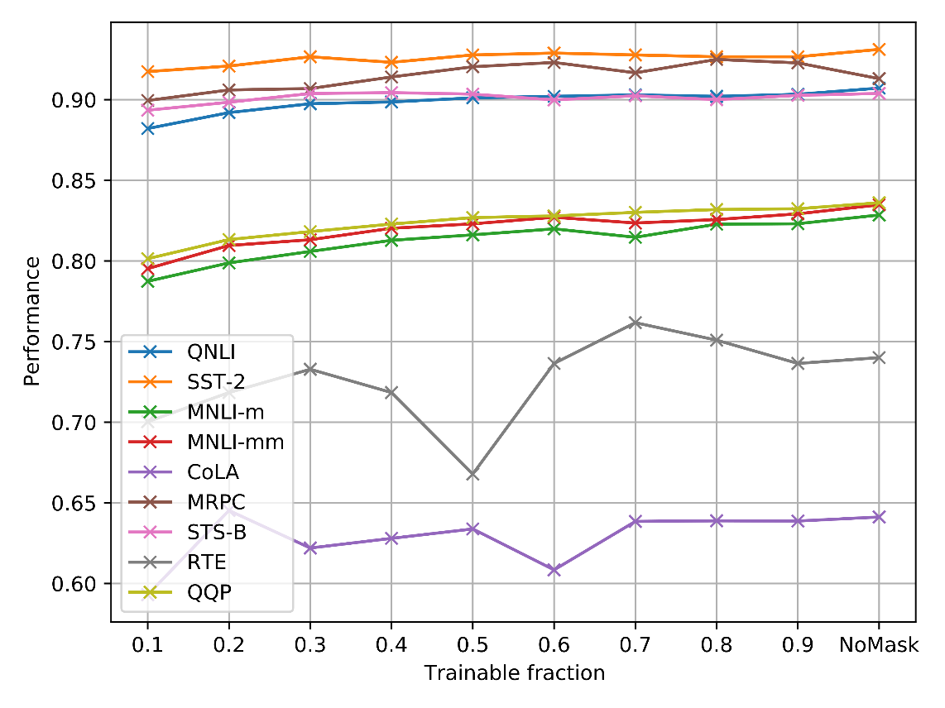
Can we train with even lower parameters?
Can we only train a subset of LayerNorm parameters
For each GLUE task, we used Fisher information to pick a subset of LayerNorm
Based on the Fisher Information, we picked a fraction of LayerNorm, like f, and freeze other parameters in LayerNorm
0 < f < 1
Other components were frozen

Slide 17
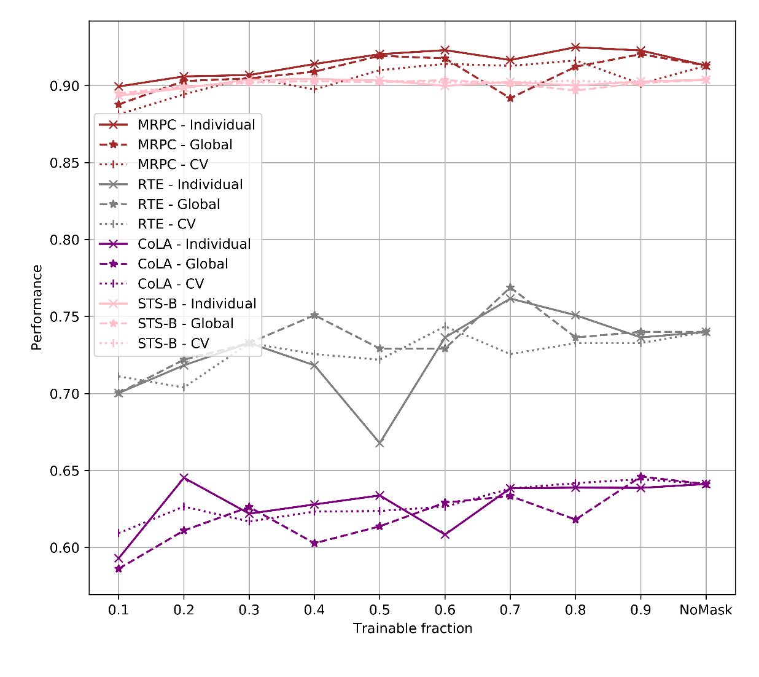
Global subset
In the previous experiment, for each task, we chose a subset of LayerNorm based on the information of that task.
Global subset -> One subset for all tasks
Or alternatively,
Cross-validation -> For each task, subset is picked based on other tasks

Slide 18
Conclusions
Full fine-tuning is computationally expensive
Solution: parameter-efficient fine-tuning
The most important part of the model must be trained
LayerNorm undergoes the most change
Comparable performance to existing methods
Less parameters

Slide 19

Thank you for your attention!

Slide 20
Slow training
internal covariate shift:
adjustments in the parameters of a certain intermediate layer will cause a change in the distribution of the input to the next layer
Requiring a lower learning rate
Carful parameter initialization
Unstable learning

Slide 21
Normalization
Solution: Normalization
Batch normalization: Compute mean and variance of each feature in each mini-batch
Then normalize the value of each feature based on the statistics of the batch
This makes the model robust against internal covariate shift…
However, there are some short-comings

Slide 22
Motivations
Batch normalization is less effective in RNNs due to the sequential nature of the data
RNN
issues
Dependance of each batch becomes a problem when statistics of different batches are significantly different (NLP)
Batch Dependency
Dependency on batch size can introduce variability in the normalization process, especially with small mini-batch sizes
Batch size dependency
Inference isssues
Inability to maintain criticality
The optimal point between co-variance explosion and co-variate decay, called criticality is not maintained by batch normalization
Requires maintaining running averages of the mean and variance during training. Can make the test complicated, in case of distribution shift

Slide 23
Features
Features
Samples
Samples
Batch Normalization
Layer Normalization

Slide 24

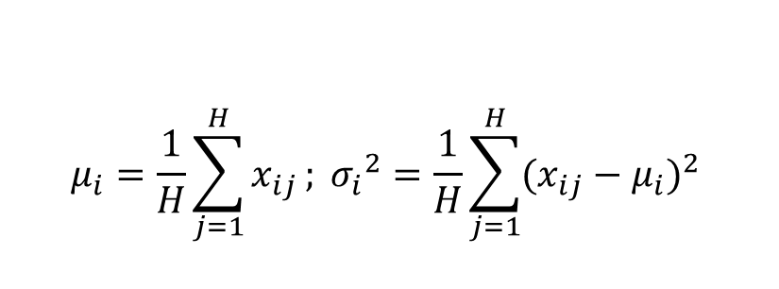
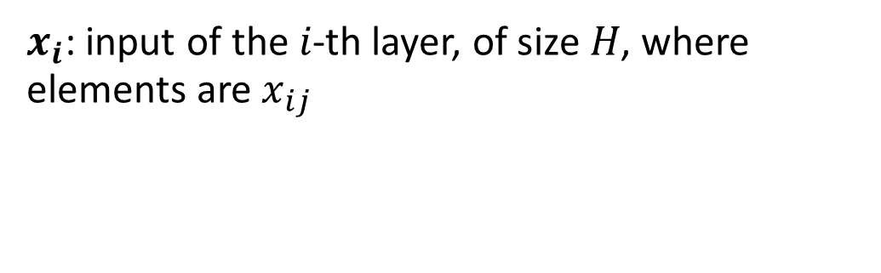

LayerNorm
$$μ_{i}=\frac{1}{H}\sum_{j=1}^{H}{x_{ij}}; {σ_{i}}^{2}=\frac{1}{H}\sum_{j=1}^{H}{{(x_{ij}−μ_{i})}^{2}}$$
$x_{i}$: input of the 𝑖-th layer, of size 𝐻, where elements are $x_{ij}$
$$\hat{x_{ij}}=\frac{x_{ij}−μ_{i}}{\sqrt{σ^{2}+ε}}$$
$$y_{i}=w⊙\hat{x_{i}}+b$$
Learnable parameters

Slide 25
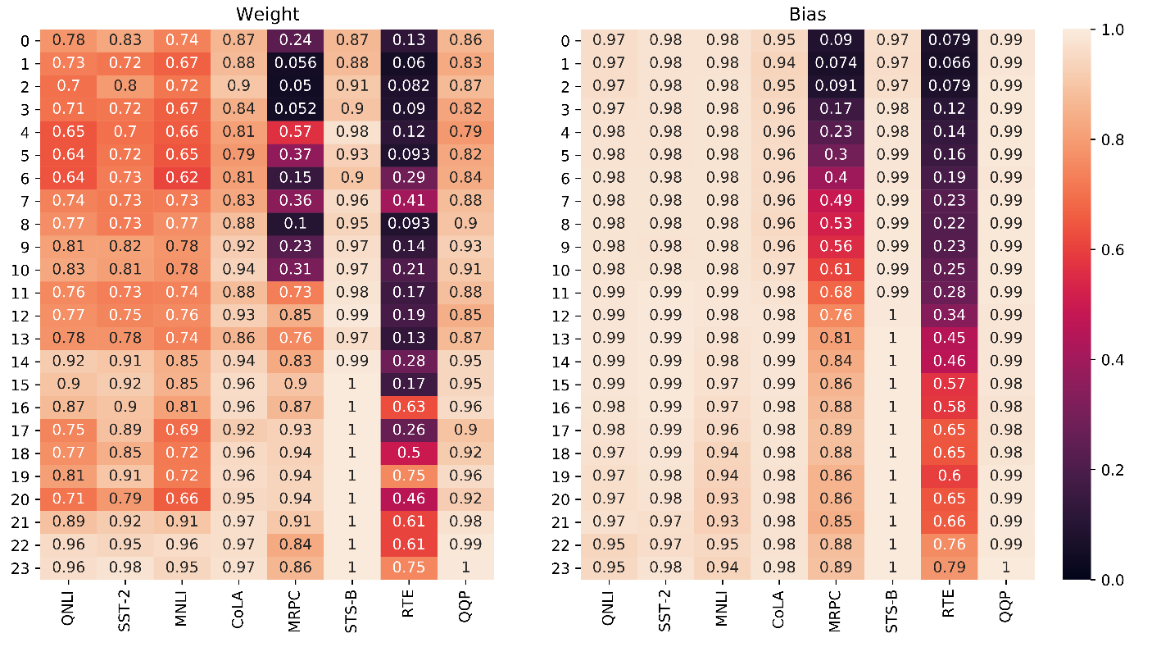
Fisher Information heatmap

Slide 26
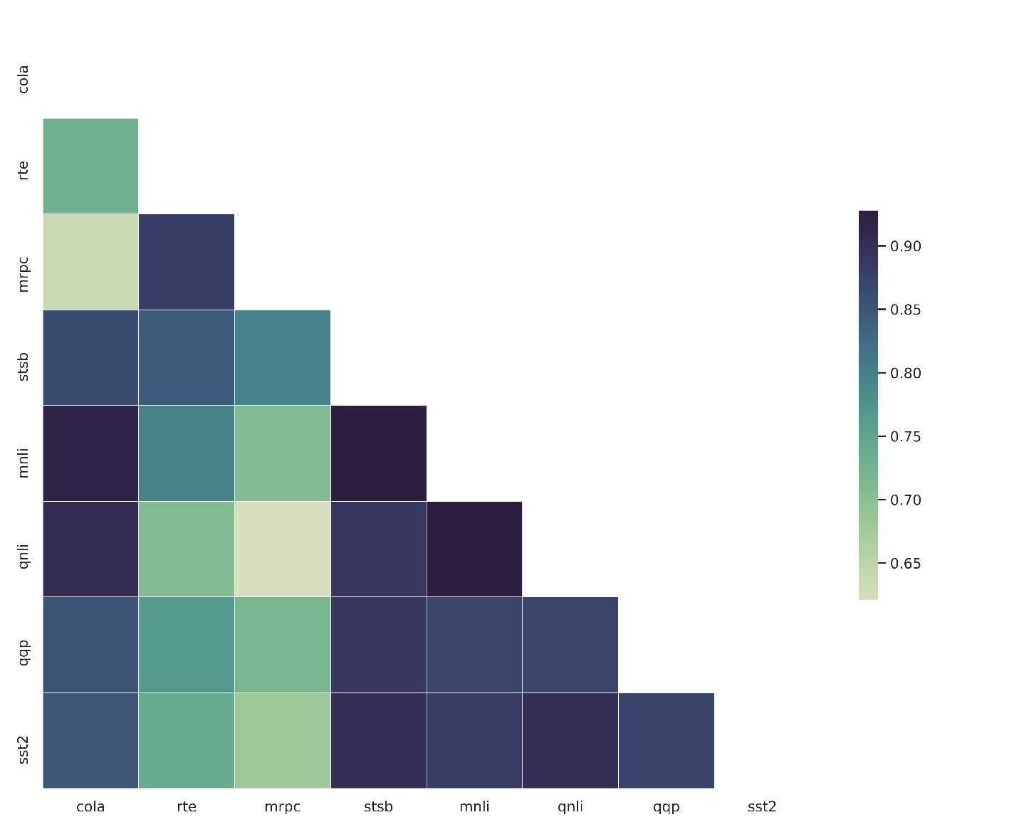
Correlation of Fisher Information in different tasks
The chosen subset is the same in different tasks?
Or changes from one task to another?
Correlation of information between different tasks

Slide 27
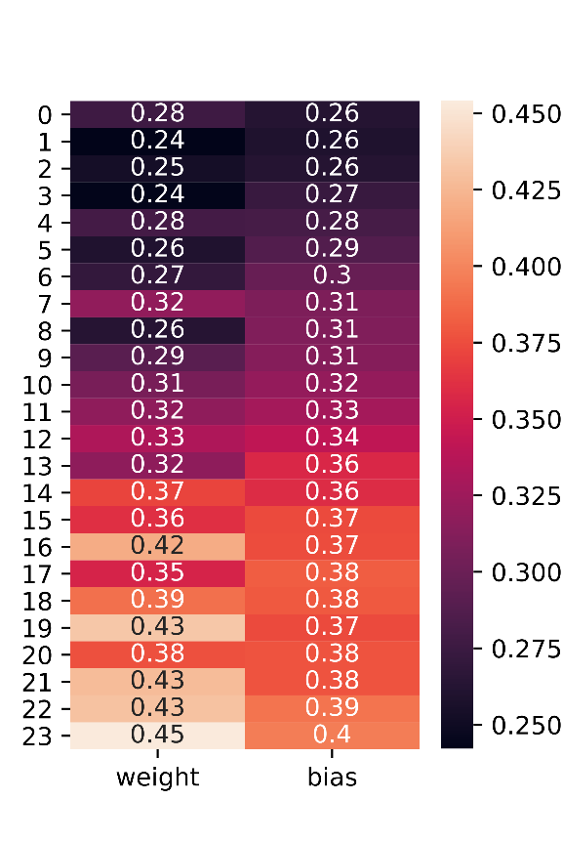
Global Subset Information
More Information

